Slide 1

An Introduction to Self-Supervised Learning
Ming Li, Jie Li, Rongrong Ji
Media Analytics and Computing Laboratory
Xiamen University
Updated on December 18, 2021

Slide 2
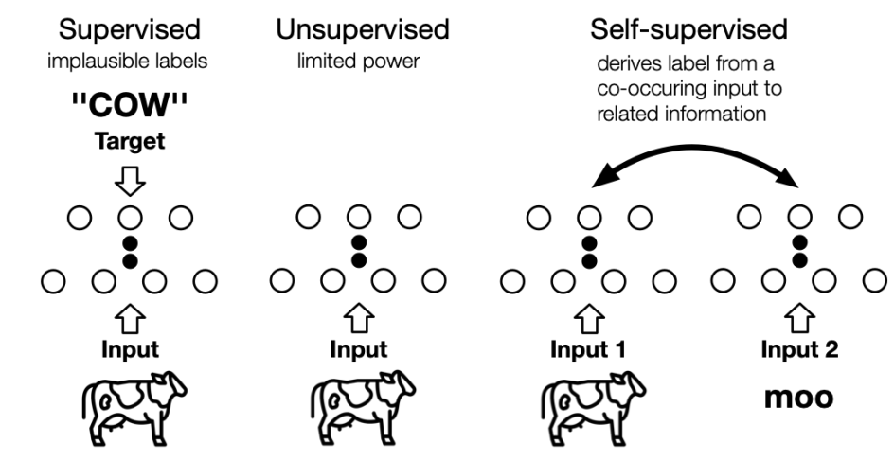
Learning Paradigms
Self-supervised Learning: Generative or Contrastive

Slide 3
Why Self-Supervised Learning ?
Labeling data is time-consuming and expensive
The model learned using supervised learning is highly task-related and may not be well transferred to other tasks
The value and information of the data itself is much higher than the labels

Slide 4
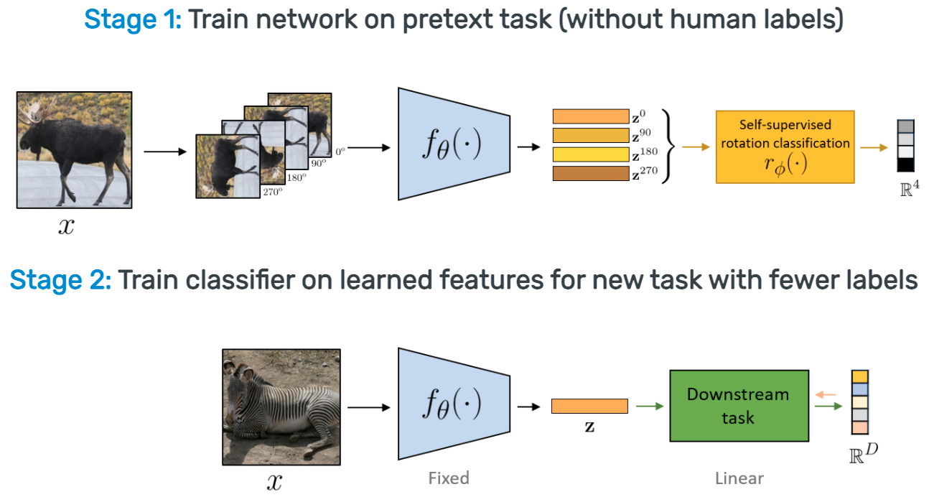
Self-Supervised Learning Pipeline
Advances in Self-Supervised Learning

Slide 5
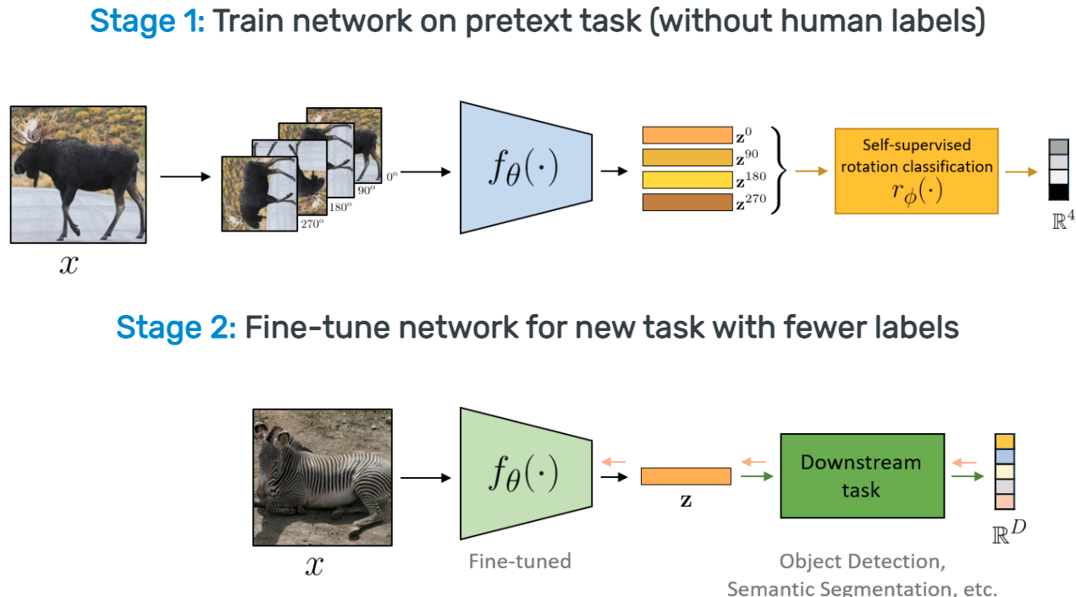
Self-Supervised Learning Pipeline
Advances in Self-Supervised Learning

Slide 6
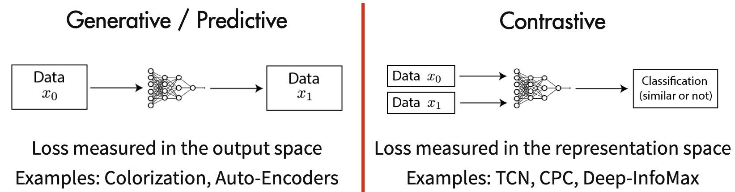
Generative SSL and Contrastive SSL
Contrastive Self-Supervised Learning | Ankesh Anand’s Blog

Slide 7
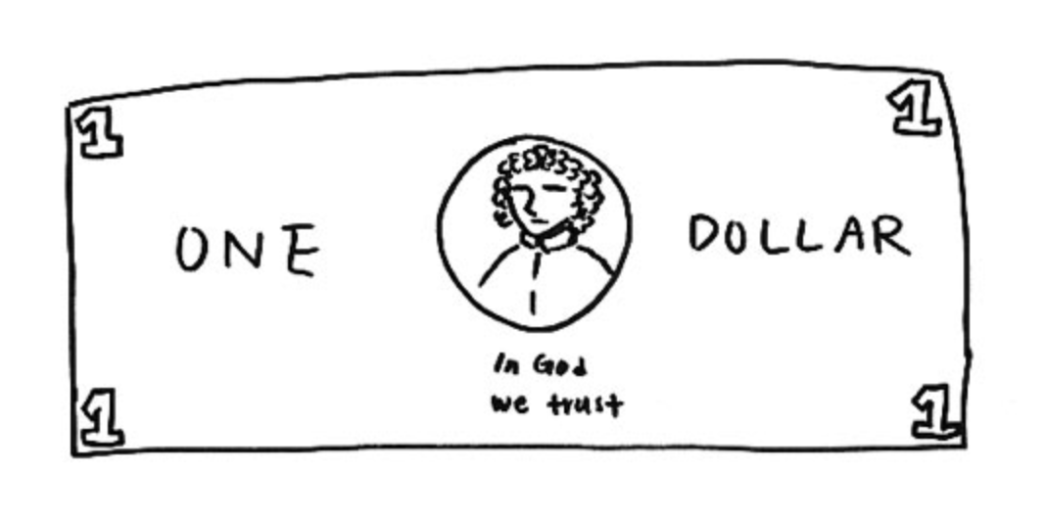
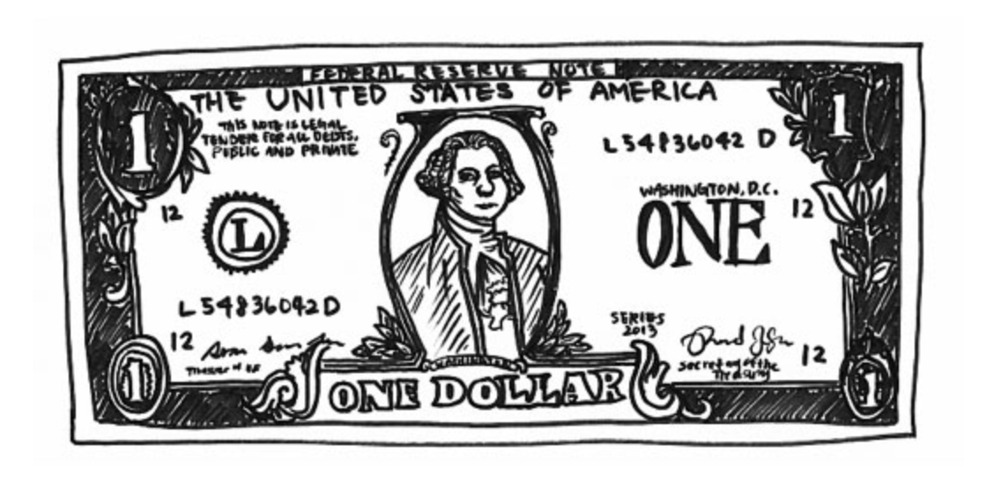
What Makes Good for Contrastive SSL?
A good representation algorithm does not necessarily need to pay attention to every detail of the sample (such as generative SSL), as long as the learned features can distinguish it from other samples.
For example, in the above pictures, we only need to draw the picture on the left to know that it is a dollar, instead of drawing a dollar completely like the picture on the right.
Contrastive Self-Supervised Learning | Ankesh Anand’s Blog

Slide 8
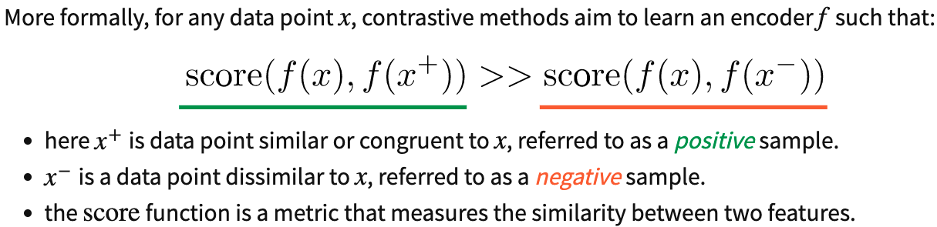
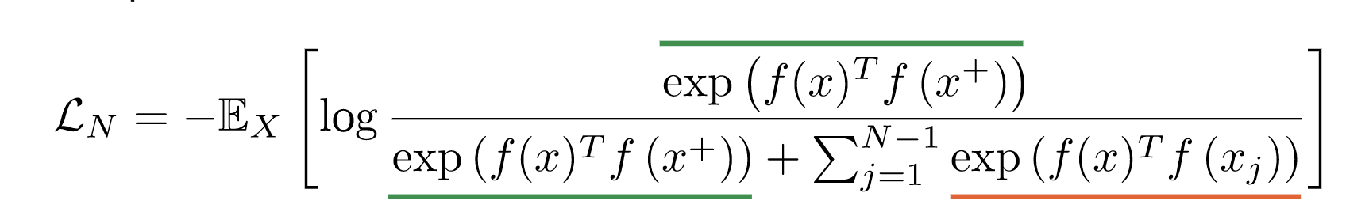
How Do Contrastive Methods Work?
InfoNCE (Contrastive) Loss
Contrastive Self-Supervised Learning | Ankesh Anand’s Blog

Slide 9
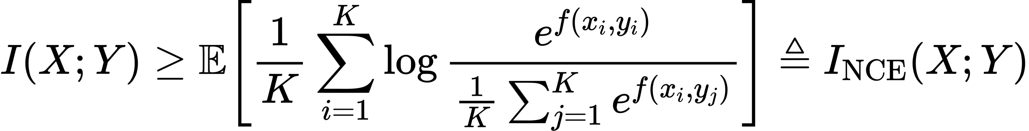
Why use InfoNCE Loss ?
The objective of self-supervised representation learning is maximizing an estimate of the mutual information (MI) between different views of the data
InfoNCE Loss is a lower bound of mutual information
On Mutual Information Maximization for Representation Learning, ICLR 2020

Slide 10
Mainstream Methods

Slide 11
MoCo
Contrastive methods tend to work better with more number of negative samples to cover the underlying distribution
MoCo proposes to decouple the batch size and the number of samples, and use a memory bank to store the previous features to obtain a large number of negative samples
MoCo uses momentum encoder to maintain the consistency between the features in the memory bank and the features in the current batch
Momentum Contrast for Unsupervised Visual Representation Learning, CVPR 2020

Slide 12
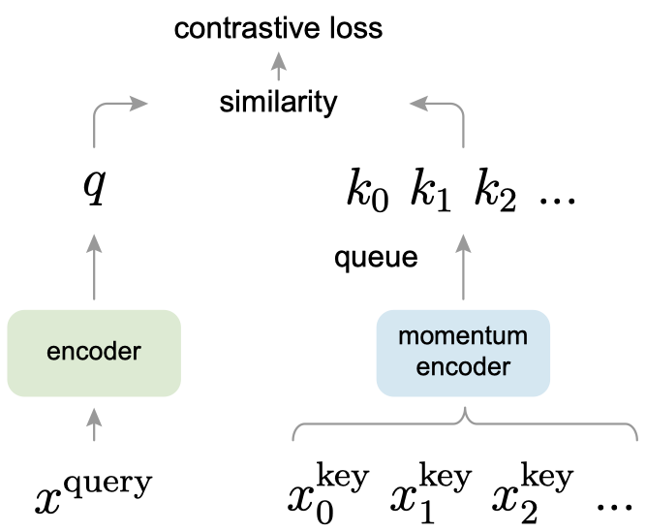
MoCo
Momentum Contrast for Unsupervised Visual Representation Learning, CVPR 2020

Slide 13
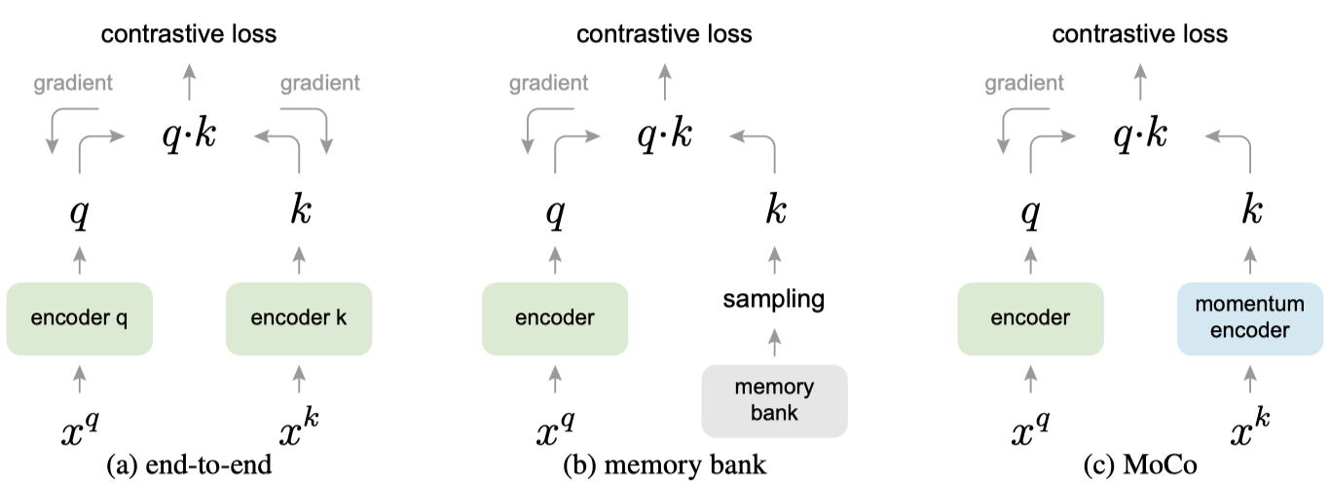
Three Contrastive Loss Mechanisms
Momentum Contrast for Unsupervised Visual Representation Learning, CVPR 2020

Slide 14
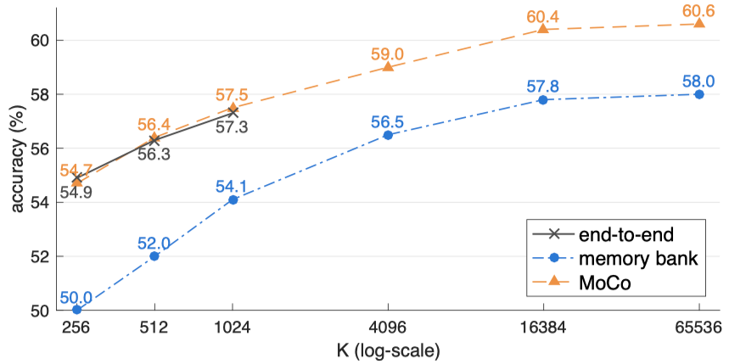
Comparison of Three Contrastive Loss Mechanisms
Momentum Contrast for Unsupervised Visual Representation Learning, CVPR 2020

Slide 15
SimCLR
Composition of data augmentations plays a critical role in deﬁning effective predictive tasks in self-supervised learning
A learnable nonlinear transformation between the representation and the contrastive loss substantially improves the quality of the learned representations
Contrastive learning beneﬁts from larger batch sizes and more training steps compared to supervised learning
A Simple Framework for Contrastive Learning of Visual Representations, ICML 2020

Slide 16
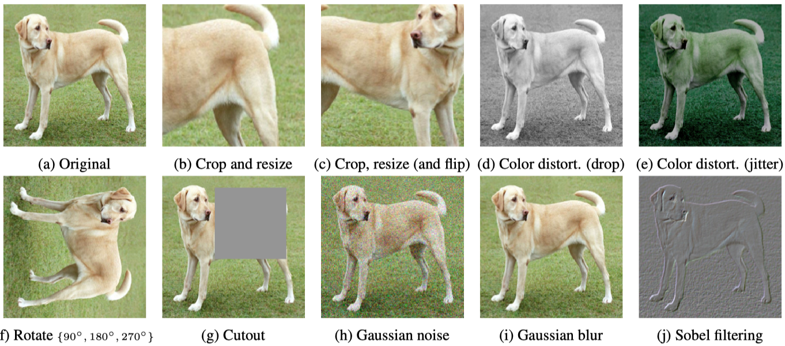
Data Augmentation for Positive Pairs
A Simple Framework for Contrastive Learning of Visual Representations, ICML 2020

Slide 17
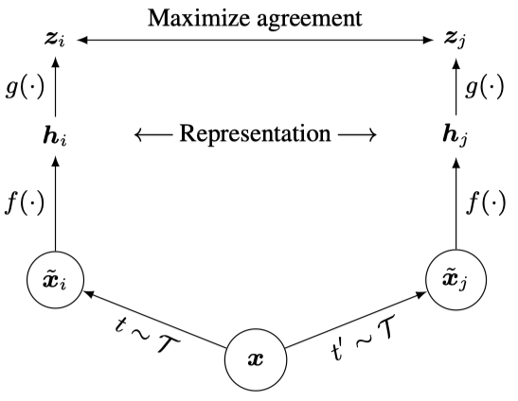
SimCLR Pipeline
A Simple Framework for Contrastive Learning of Visual Representations, ICML 2020

Slide 18
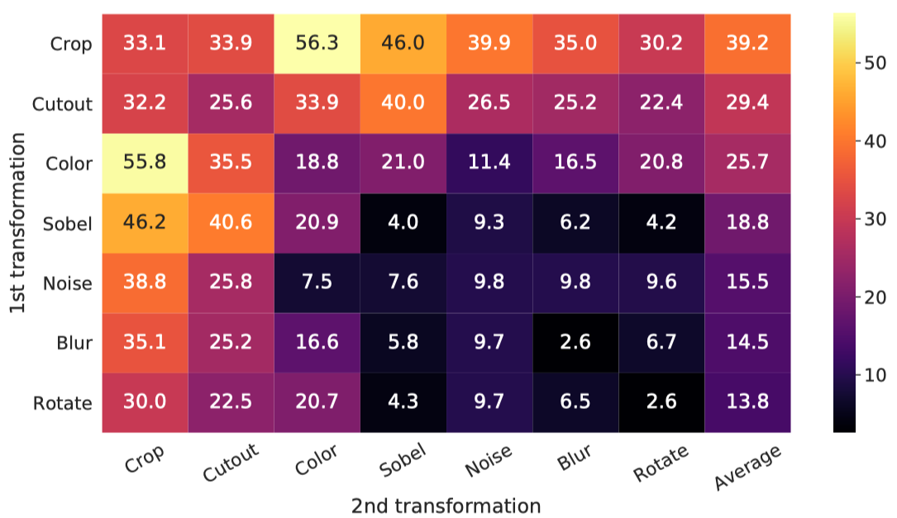
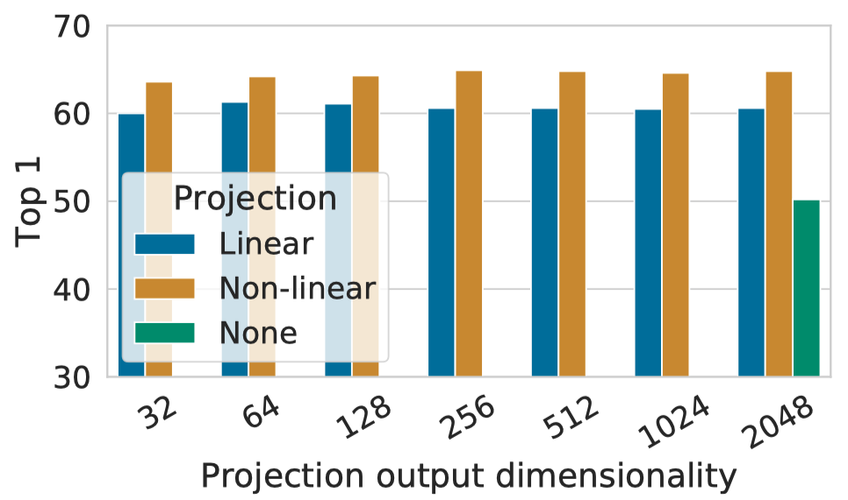
Data Augmentations and Projection Heads Matter
A Simple Framework for Contrastive Learning of Visual Representations, ICML 2020

Slide 19
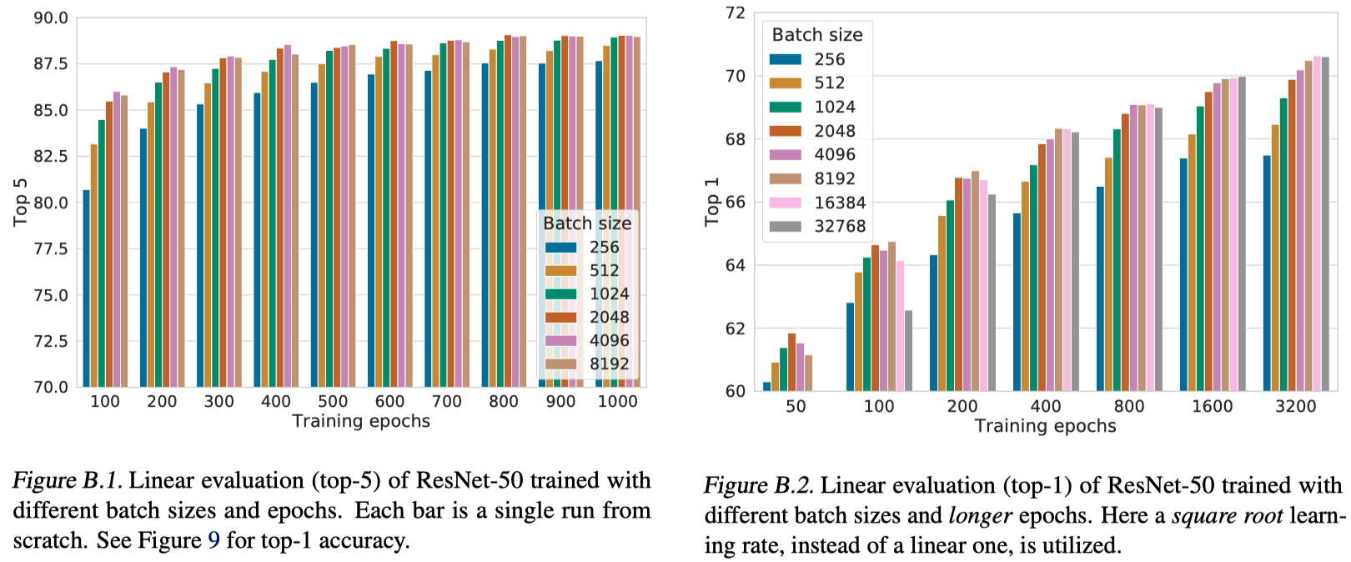
Larger Batch Sizes and longer Epochs Are Better
A Simple Framework for Contrastive Learning of Visual Representations, ICML 2020

Slide 20
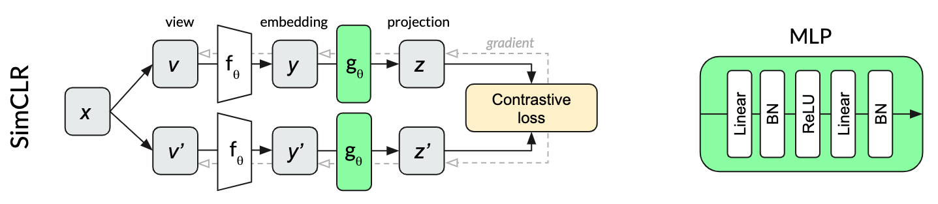
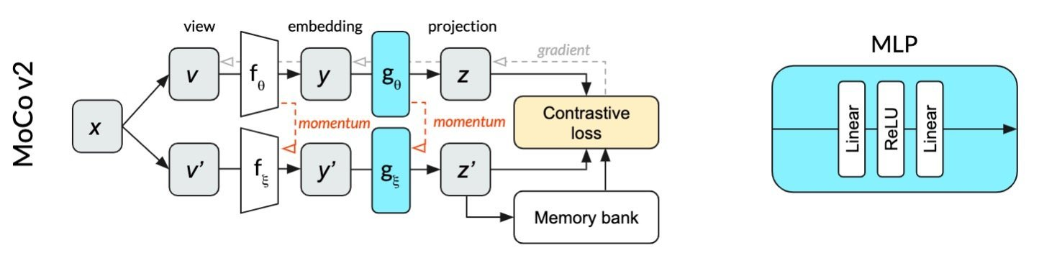
MoCo v2
Inspired by SimCLR, MoCo v2 uses a projection head, stronger data augmentation, cosine learning rate scheduler and longer training epochs to improve MoCo v1
Improved Baselines with Momentum Contrastive Learning, arXiv 2020
generally intelligent

Slide 21
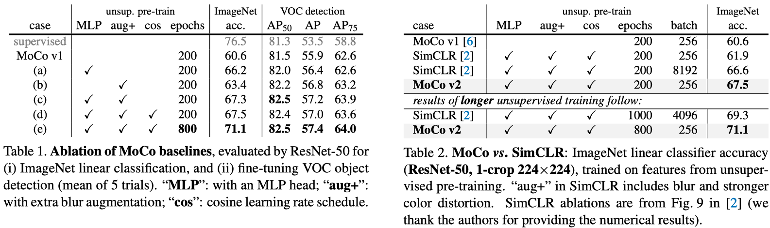
Experiments
Additional projection head, stronger data enhancement, cosine learning rate and longer training time can all bring improvements
Improved Baselines with Momentum Contrastive Learning, arXiv 2020

Slide 22
SwAV
SwAV clusters the data while enforcing consistency between cluster assignments produced for different augmentations of the same image, instead of comparing features directly as in contrastive learning
Proposed multi-crop that uses smaller-sized images to increase the number of views while not increasing the memory or computational requirements during training
Unsupervised Learning of Visual Features by Contrasting Cluster Assignments, NeurIPS 2020

Slide 23
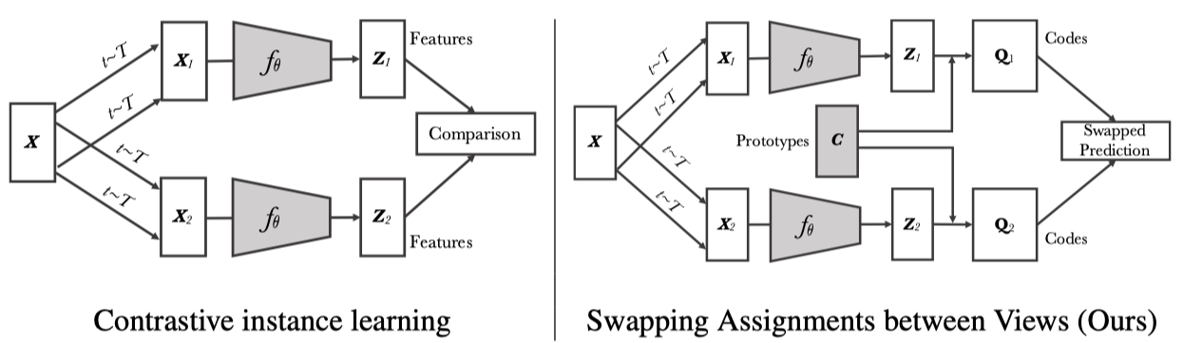
Contrastive instance learning vs. SwAV
Unsupervised Learning of Visual Features by Contrasting Cluster Assignments, NeurIPS 2020

Slide 24

Understanding SwAV
https://github.com/facebookresearch/swav
Unsupervised Learning of Visual Features by Contrasting Cluster Assignments, NeurIPS 2020

Slide 25
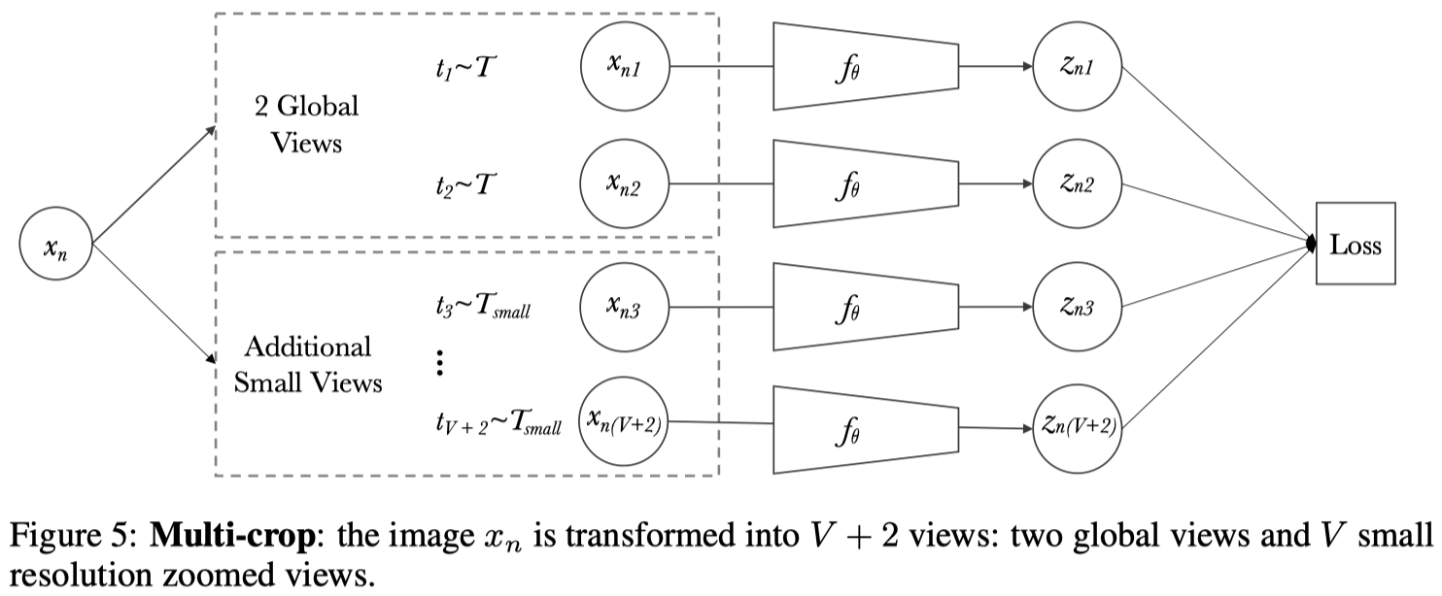
Multi-crop
Unsupervised Learning of Visual Features by Contrasting Cluster Assignments, NeurIPS 2020

Slide 26
Tricks
To avoid model collapse, i.e., all features of the current batch are clustered into a prototype, SwAV requires the instances in the current batch to be clustered into different categories evenly
SwAV uses a mix of views with different resolutions in place of two full-resolution views to avoid the bias produced by downsized images
Unsupervised Learning of Visual Features by Contrasting Cluster Assignments, NeurIPS 2020

Slide 27
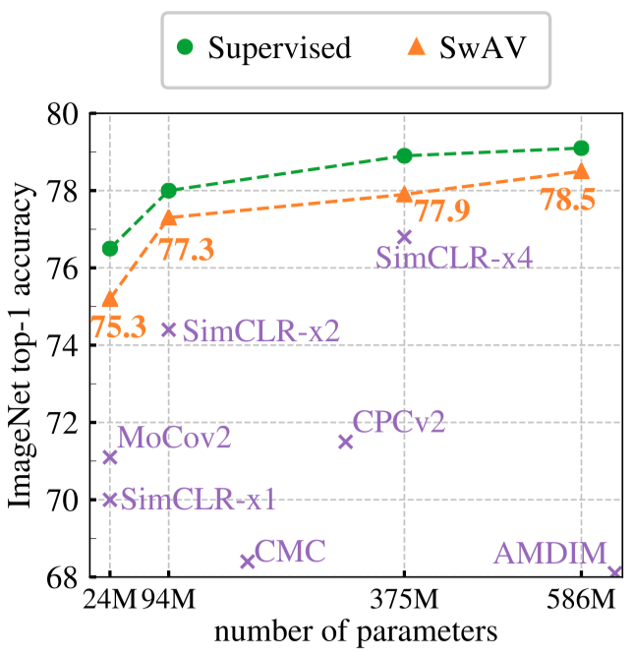
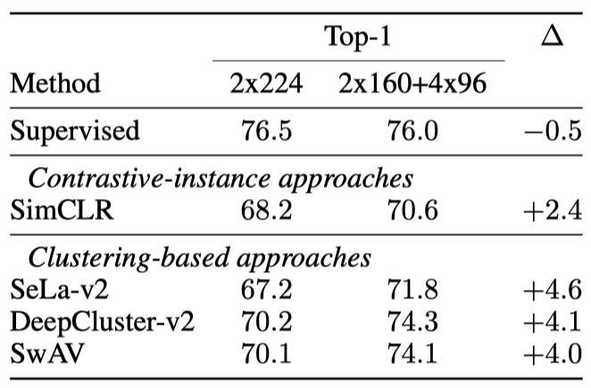
Experiments
Linear classiﬁcation on ImageNet
Effectiveness of Multi-crop
Unsupervised Learning of Visual Features by Contrasting Cluster Assignments, NeurIPS 2020

Slide 28
BYOL
BYOL achieves a new state of the art without negative pairs
BYOL uses an asymmetric network structure (an additional prediction head) and stop-gradient to avoid model collapse
Bootstrap Your Own Latent A New Approach to Self-Supervised Learning, NeurIPS 2020

Slide 29
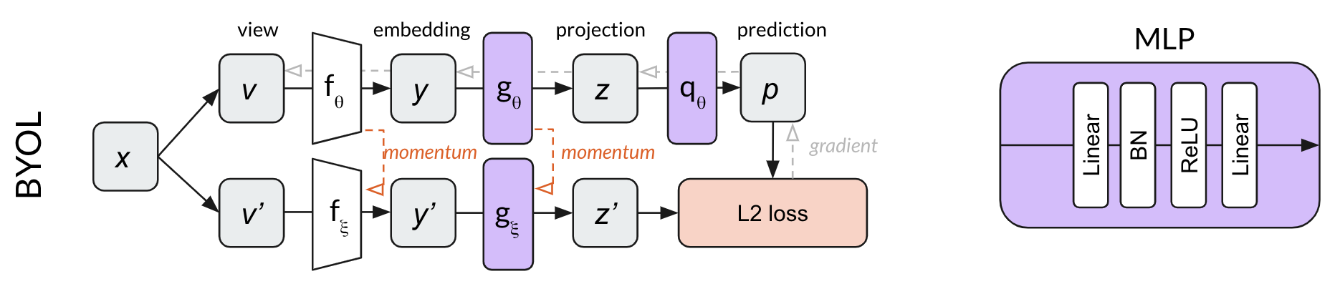
BYOL
Bootstrap Your Own Latent A New Approach to Self-Supervised Learning, NeurIPS 2020

Slide 30
generally intelligent

Slide 31
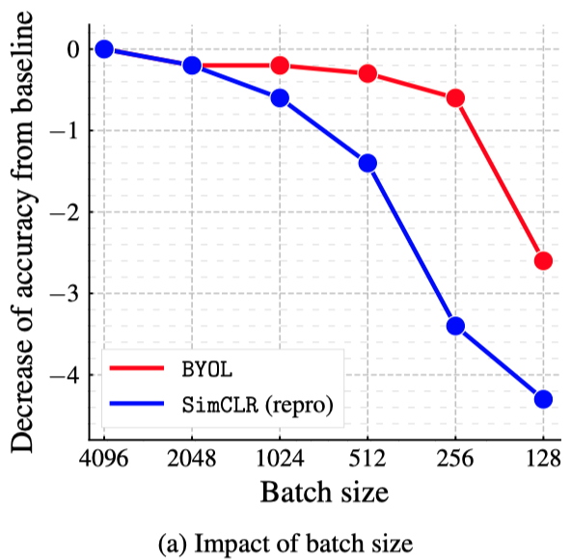
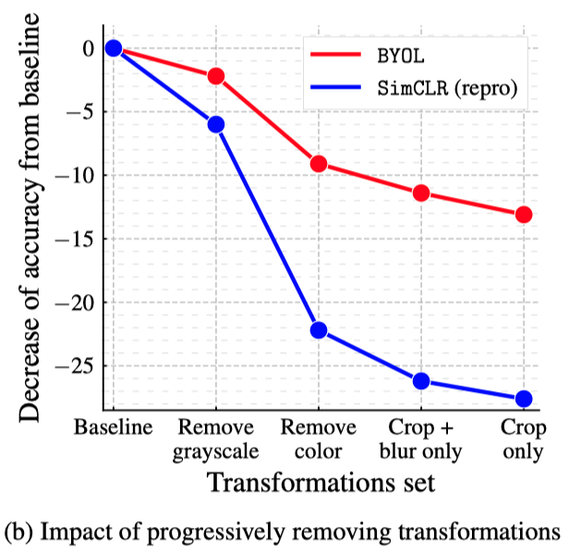
Experiments
Compared with SimCLR, BYOL is less sensitive to batch size and transformations because it does not require negative pairs
Bootstrap Your Own Latent A New Approach to Self-Supervised Learning, NeurIPS 2020

Slide 32
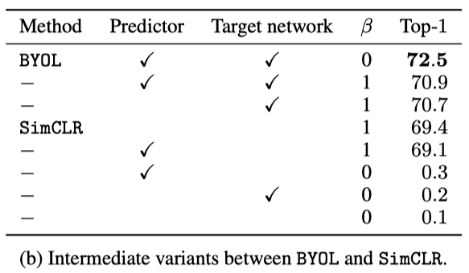
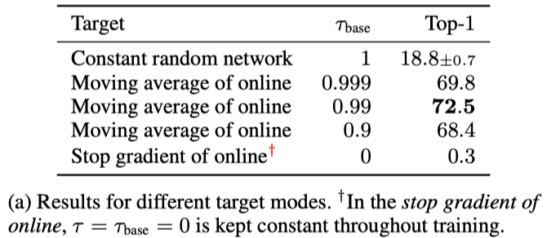
Experiments
stop-gradient and predictor are both important
Bootstrap Your Own Latent A New Approach to Self-Supervised Learning, NeurIPS 2020

Slide 33
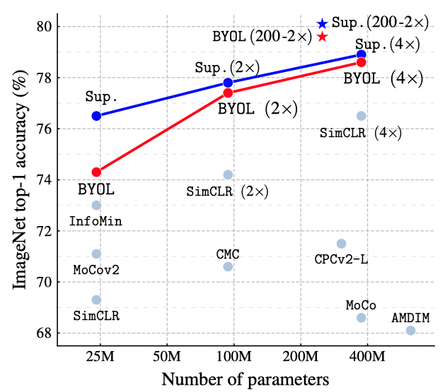
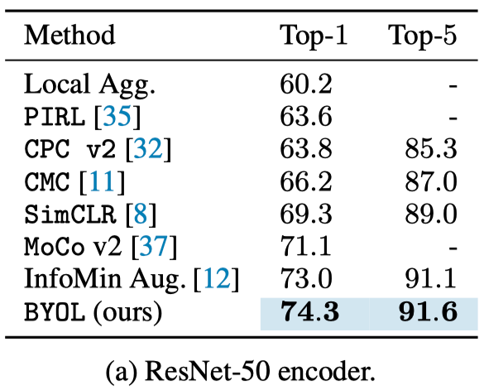
Experiments
Bootstrap Your Own Latent A New Approach to Self-Supervised Learning, NeurIPS 2020

Slide 34
SimSiam
Simple Siamese networks can learn meaningful representations even using none of the following: (i) negative sample pairs, (ii) large batches, (iii) momentum encoders
Collapsing solutions do exist for the loss and structure, but a stop-gradient operation plays an essential role in preventing collapsing
Explains the effectiveness of SimSiam from the perspective of the EM algorithm
Exploring Simple Siamese Representation Learning, CVPR 2021

Slide 35
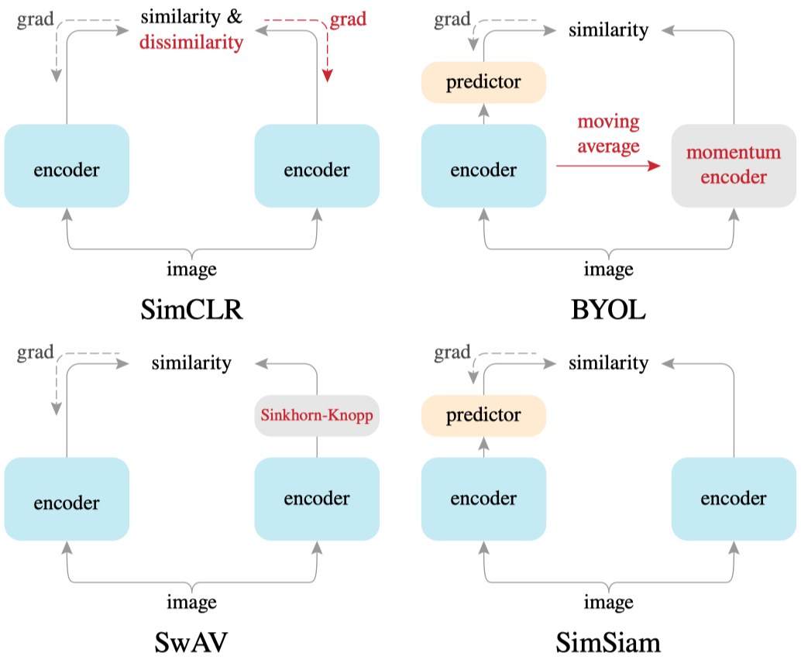
Comparison on Siamese Architectures
Exploring Simple Siamese Representation Learning, CVPR 2021

Slide 36
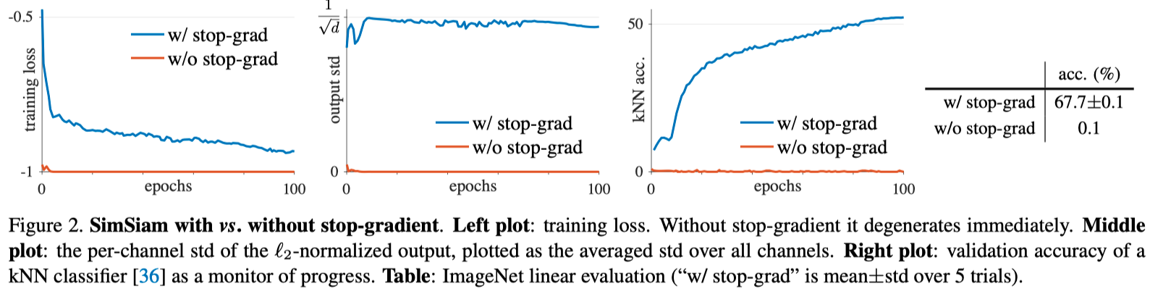
Stop-gradient is Essential to Prevent Model Collapse
Exploring Simple Siamese Representation Learning, CVPR 2021

Slide 37
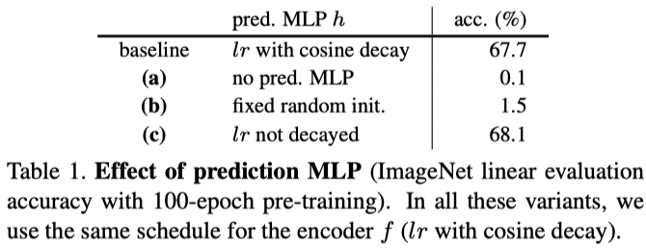
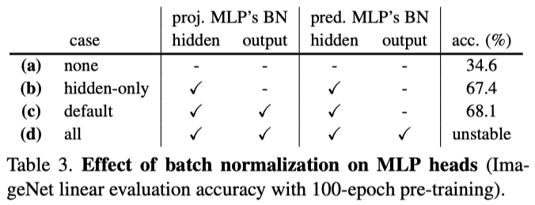
Experiments
Exploring Simple Siamese Representation Learning, CVPR 2021

Slide 38
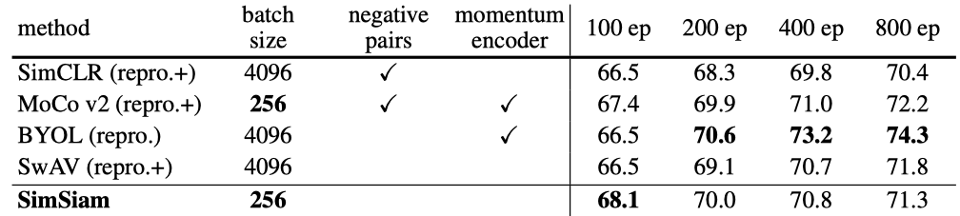
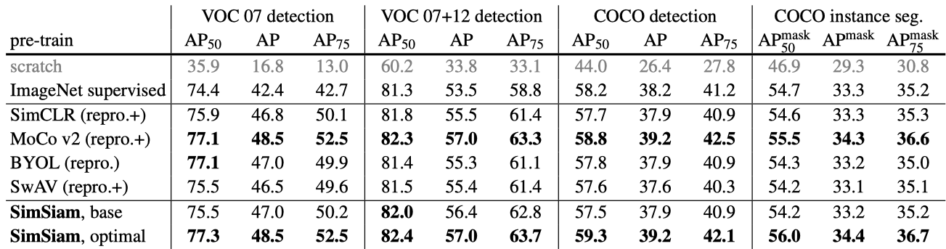
Experiments
Exploring Simple Siamese Representation Learning, CVPR 2021

Slide 39
Barlow Twins
Barlow Twins avoids model collapse by measuring the cross-correlation matrix between two views of a sample and making it as close to the identity matrix as possible
Barlow Twins can prevent model collapse without the need for negative pairs, asymmetric structure or clustering features
Barlow Twins: Self-Supervised Learning via Redundancy Reduction, ICML 2021

Slide 40
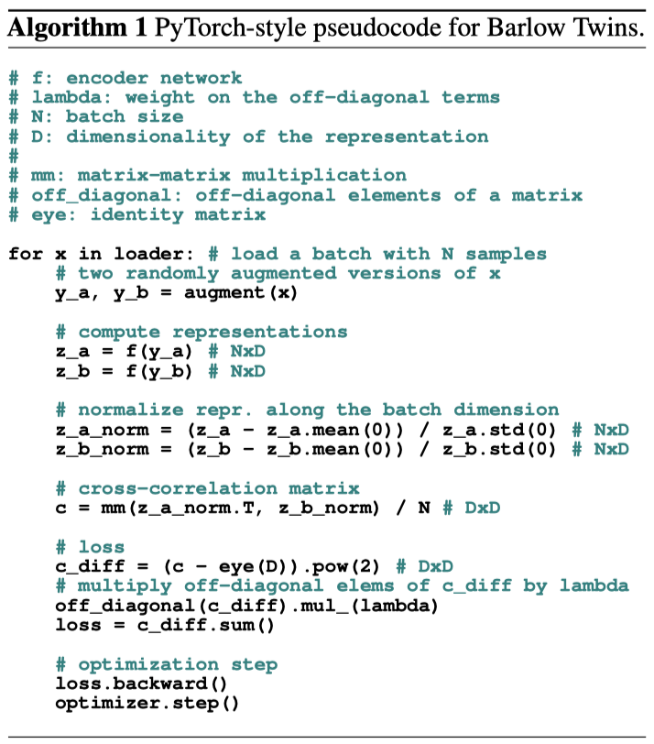
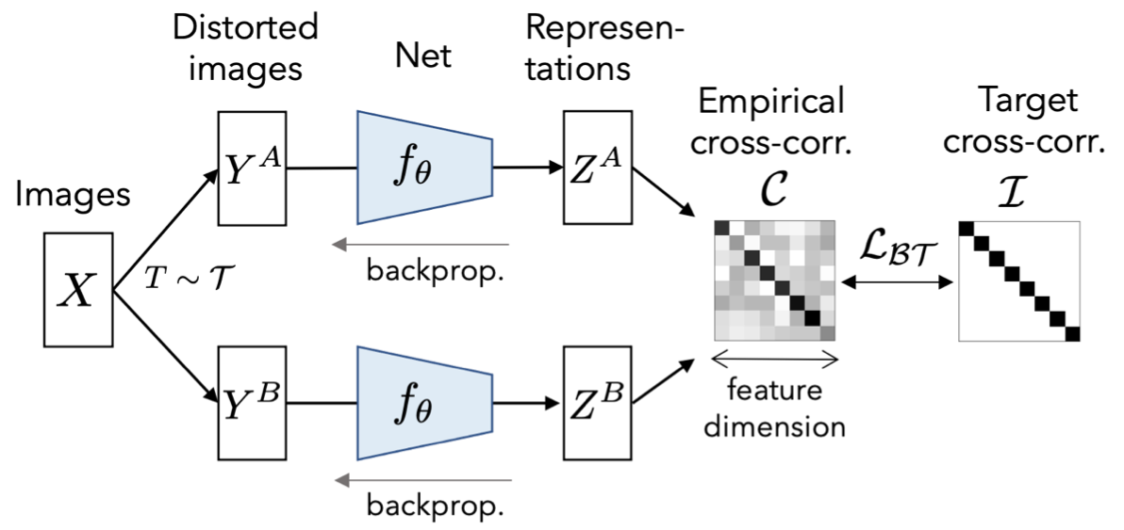
Barlow Twins
Barlow Twins: Self-Supervised Learning via Redundancy Reduction, ICML 2021

Slide 41
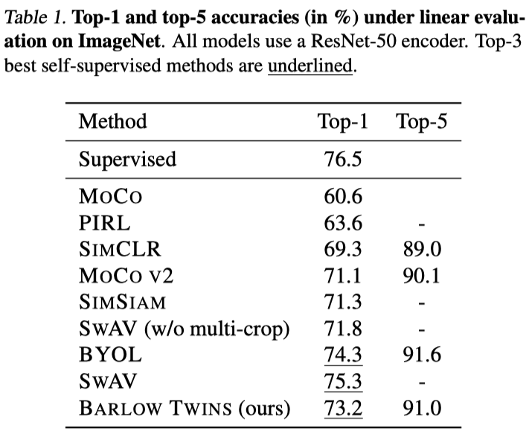
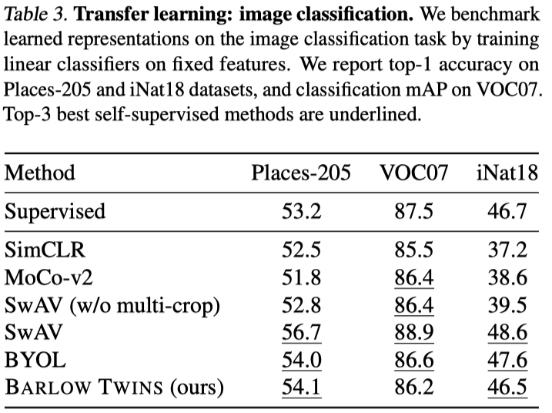
Experiments
Barlow Twins: Self-Supervised Learning via Redundancy Reduction, ICML 2021

Slide 42
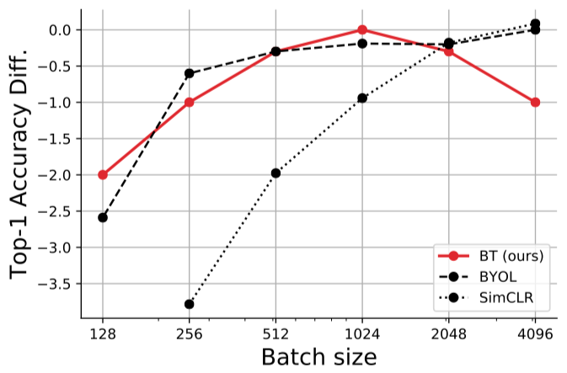
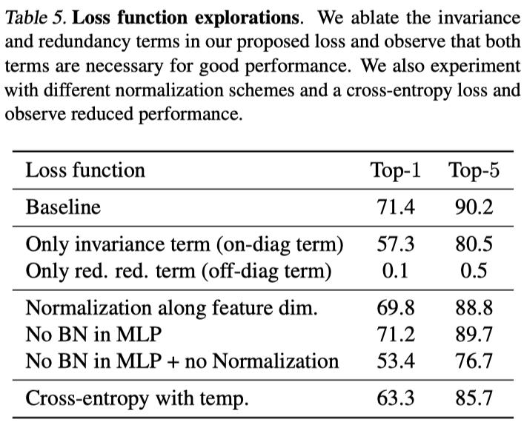
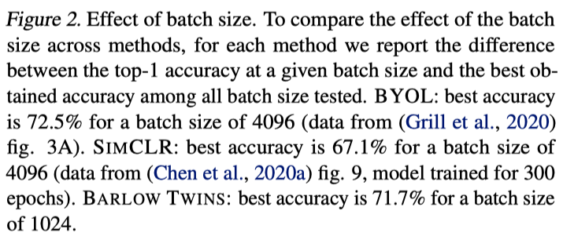
Ablations
Barlow Twins: Self-Supervised Learning via Redundancy Reduction, ICML 2021

Slide 43
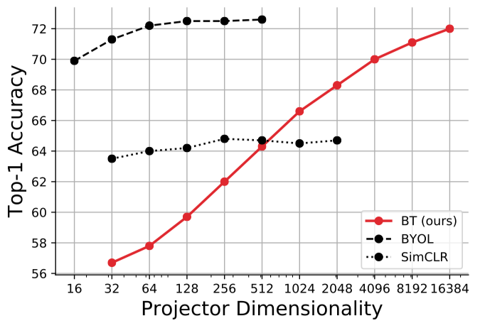
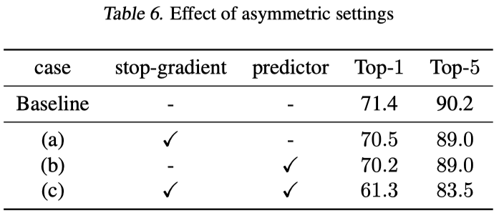
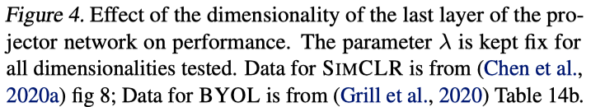
Ablations
Barlow Twins: Self-Supervised Learning via Redundancy Reduction, ICML 2021

Slide 44
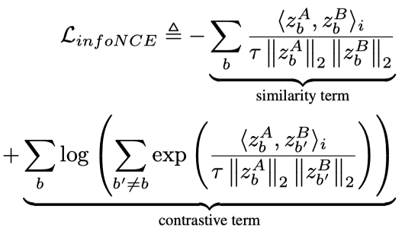
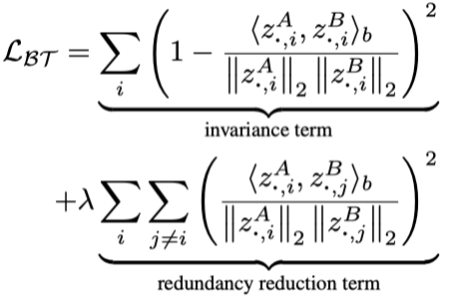
Connection with InfoNCE
Barlow Twins: Self-Supervised Learning via Redundancy Reduction, ICML 2021

Slide 45
Understanding Contrastive SSL

Slide 46
Alignment and Uniform
Alignment: two samples forming a positive pair should be mapped to nearby features, and thus be (mostly) invariant to unneeded noise factors
Uniformity: feature vectors should be roughly uniformly distributed on the unit hypersphere, preserving as much information of the data as possible
Both alignment and uniformstrongly agree with downstream task performance
Understanding Contrastive Representation Learning through Alignment and Uniformity on the Hypersphere, ICML 2020

Slide 47
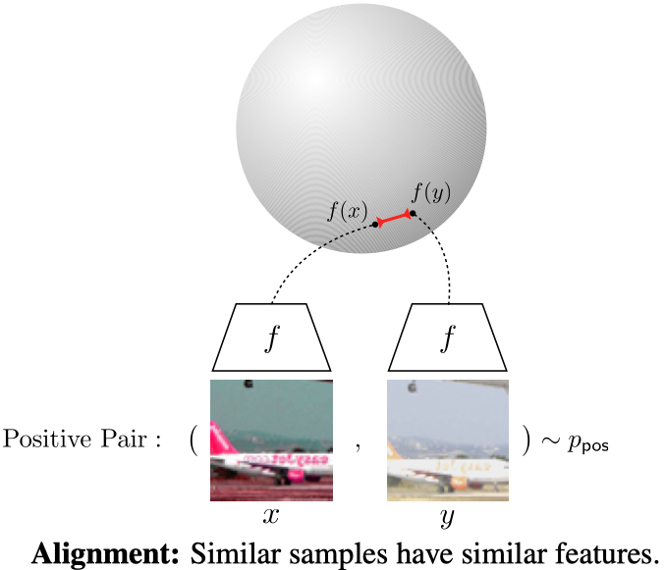

Understanding Alignment and Uniform
Understanding Contrastive Representation Learning through Alignment and Uniformity on the Hypersphere, ICML 2020

Slide 48








Alignment and Uniform Analysis
Understanding Contrastive Representation Learning through Alignment and Uniformity on the Hypersphere, ICML 2020

Slide 49


Optimizing Alignment and Uniform
Alignment
Uniform
Understanding Contrastive Representation Learning through Alignment and Uniformity on the Hypersphere, ICML 2020

Slide 50


Experiments
Directly optimizing only alignment and uniform can lead to better representations
Understanding Contrastive Representation Learning through Alignment and Uniformity on the Hypersphere, ICML 2020

Slide 51

Experiments
Both alignment and uniform strongly agree with downstream task performance.
Understanding Contrastive Representation Learning through Alignment and Uniformity on the Hypersphere, ICML 2020

Slide 52

Experiments
Both alignment and uniform causally affect downstream task performance
Understanding Contrastive Representation Learning through Alignment and Uniformity on the Hypersphere, ICML 2020

Slide 53
The Behavior of Contrastive Loss
The contrastive loss is a hardness-aware loss function, and the temperature τ controls the strength of penalties on hard negative samples
The hardness-aware property is signiﬁcant to the success of the softmax-based contrastive loss
Too low temperature or too high temperature lead to worse representation
Understanding the Behaviour of Contrastive Loss, CVPR 2021

Slide 54


Simple Loss and Contrastive Loss
Understanding the Behaviour of Contrastive Loss, CVPR 2021

Slide 55


The Role of Temperature
τ -> 0, only focus on the most hard negative sample
τ -> ∞, the contrastive loss degraded to simple loss
Understanding the Behaviour of Contrastive Loss, CVPR 2021

Slide 56


Hard Negative Mining
Understanding the Behaviour of Contrastive Loss, CVPR 2021

Slide 57

Verify the Role of Temperature
Understanding the Behaviour of Contrastive Loss, CVPR 2021

Slide 58
Better Sampling and Harder Samples

Slide 59
Debiased Sampling
Debiased contrastive learning develop a new, debiased contrastive objective that corrects for the sampling bias of negative examples, while only assuming access to positive examples and the unlabeled data
With debiased sampling, the proposed objective consistently outperforms the state-of-the-art for representation learning in vision, language, and reinforcement learning benchmarks.
Debiased Contrastive Learning, NeurIPS 2020

Slide 60

Sampling Bias
Debiased Contrastive Learning, NeurIPS 2020

Slide 61

Experiments
Debiased Contrastive Learning, NeurIPS 2020

Slide 62
Hard Negatives
The key challenge toward using hard negatives is that contrastive methods must remain unsupervised, making it infeasible to adopt existing negative sampling strategies that use true similarity information
This paper develop a new family of unsupervised sampling methods for selecting hard negative samples where the user can control the hardness
Contrastive learning with hard negative samples, ICLR 2021

Slide 63

Hard Negative Mining
Contrastive learning with hard negative samples, ICLR 2021

Slide 64

Experiments
Contrastive learning with hard negative samples, ICLR 2021

Slide 65
MoCoRing
Randomly sampled negative examples often include many uninformative examples either because they are too easy or too hard to discriminate
Semi-hard negatives can yield stronger contrastive representations
The naive strategy of sampling hard negatives throughout training can be detrimental. We then show that slowly introducing harder negatives yields good performance.
Conditional negative sampling for contrastive learning of visual representations, ICLR 2021

Slide 66

MoCoRing
Epochs
Conditional negative sampling for contrastive learning of visual representations, ICLR 2021

Slide 67
Feature Transformation
Harder positives can used to boost the learning because hard positives enable the model to be more view-invariant
Diversified negatives make the model more discriminative
This paper proposes to create hard positives and diversified negatives by feature transformation
Improving Contrastive Learning by Visualizing Feature Transformation, ICCV 2021

Slide 68

Hard Positives Can Learn Better Representation
Improving Contrastive Learning by Visualizing Feature Transformation, ICCV 2021

Slide 69

Interpolation for Positives and Negatives
Improving Contrastive Learning by Visualizing Feature Transformation, ICCV 2021

Slide 70
Focus on Downstream Tasks

Slide 71

Is Image-Level Contrast Learning Good Enough?

Slide 72


Pixel-level Contrastive Learning
Propagate Yourself: Exploring Pixel-Level Consistency for Unsupervised Visual Representation Learning, CVPR 2021

Slide 73

Patch-level Contrastive Learning
Dense Contrastive Learning for Self-Supervised Visual Pre-Training, CVPR 2021

Slide 74

Different Augmentations for Different Tasks
What Should Not Be Contrastive in Contrastive Learning, ICLR 2021

Slide 75
Beyond Image Contrastive Learning

Slide 76

Multi-modal Self-Supervised Learning
Self-supervised Co-training for Video Representation Learning, NeurIPS 2020

Slide 77

Video Classification
VideoMoCo: Contrastive Video Representation Learning with Temporally Adversarial Examples, CVPR 2021

Slide 78

Video Self-supervised Learning
Removing the Background by Adding the Background: Towards Background Robust Self-supervised Video Representation Learning, CVPR 2021

Slide 79

Object Tracking
Rethinking Self-supervised Correspondence Learning: A Video Frame-level Similarity Perspective, ICCV 2021

Slide 80
What’s New in Self-Supervised Learning?

Slide 81
ReSSL
A distribution-based(relation-based) contrastive learning paradigm, similar to SwAV
SwAV uses multiple prototypes to calculate the similarity distribution, while ReSSL uses other samples of the current batch to calculate the similarity distribution
Introduce the consistency regularization paradigm in semi-supervised learning to self-supervised learning
ReSSL: Relational Self-Supervised Learning with Weak Augmentation, NeurIPS 2021

Slide 82

ReSSL
ReSSL: Relational Self-Supervised Learning with Weak Augmentation, NeurIPS 2021

Slide 83

Experiments
ReSSL: Relational Self-Supervised Learning with Weak Augmentation, NeurIPS 2021

Slide 84


Consistency Regularization is Very Important
ReSSL: Relational Self-Supervised Learning with Weak Augmentation, NeurIPS 2021

Slide 85
Decoupled Contrastive Learning
InfoNCE based contrastive learning can be seen as a coupling of two tasks, i.e., pull the positive closer and push the negative apart.
The negative-positive-coupling (NPC) effect, leading to unsuitable learning efﬁciency with respect to the batch size.
By decoupling the NPC effect, we can signiﬁcantly improving SSL efﬁciency.
Decoupled Contrastive Learning, arXiv 2021

Slide 86

Negative-Positive-Coupling Effect
Decoupled Contrastive Learning, arXiv 2021

Slide 87



Decoupled Contrastive Learning Loss
InfoNCE
Decoupled Contrastive Learning Loss
Weighted DCL Loss
Decoupled Contrastive Learning, arXiv 2021

Slide 88


Experiments
Decoupled Contrastive Learning, arXiv 2021

Slide 89

Experiments
Decoupled Contrastive Learning, arXiv 2021

Slide 90


Multiple Collapses of SSL
On Feature Decorrelation in Self-Supervised Learning, ICCV 2021

Slide 91
SSL for Visual Transformers

Slide 92
MoCo v3
Study the self-supervised learning of visual transformers (ViT).
Training instability that caused by patch projection (first layer in ViT) is a major issue that degrades accuracy, and it can be hidden by apparently good results.
A fixed random patch projection is proposed to make training more stable and achieve higher accuracy.
An Empirical Study of Training Self-Supervised Vision Transformers, ICCV 2021

Slide 93


The Instability of Training
An Empirical Study of Training Self-Supervised Vision Transformers, ICCV 2021

Slide 94


Fixed Random Patch Projection Lear to Higher Accuracy and More Stable
An Empirical Study of Training Self-Supervised Vision Transformers, ICCV 2021

Slide 95
DINO
Study the difference of self-supervised learning between ViT and convolution.
Self-supervised ViT features contain explicit information about the semantic segmentation of an image, which does not emerge as clearly with supervised ViTs, nor with convnets.
Features learned by self-supervised ViT are also excellent k-NN classiﬁers.
Emerging Properties in Self-Supervised Vision Transformers, arXiv 2021

Slide 96


Method
Emerging Properties in Self-Supervised Vision Transformers, arXiv 2021

Slide 97



Attention Maps
Emerging Properties in Self-Supervised Vision Transformers, arXiv 2021

Slide 98


Experiments
Emerging Properties in Self-Supervised Vision Transformers, arXiv 2021

Slide 99
Generative SSL in Computer Vision

Slide 100
BEiT
Proposed the first masked image modeling task to pretrain vision Transformers.
We ﬁrst “tokenize” the original image into visual tokens. Then we randomly mask some image patches and fed them into the backbone Transformer.
The pre-training objective is to recover the original visual tokens based on the corrupted image patches.
BEiT: BERT Pre-Training of Image Transformers , arXiv 2021, video

Slide 101

Image Tokenizer (CLIP + dVAE)
Learning Transferable Visual Models From Natural Language Supervision, ICML 2021
BEiT: BERT Pre-Training of Image Transformers , arXiv 2021

Slide 102

Pipeline
BEiT: BERT Pre-Training of Image Transformers , arXiv 2021

Slide 103

Fine-Tuning BEiT on Downstream Tasks
BEiT: BERT Pre-Training of Image Transformers , arXiv 2021

Slide 104


Experiments
BEiT: BERT Pre-Training of Image Transformers , arXiv 2021

Slide 105


Ablation Studies
BEiT: BERT Pre-Training of Image Transformers , arXiv 2021

Slide 106
Masked AutoEncoder
A generative SSL paradigm that can surpass contrastive SSL in computer vision domain.
A asymmetric encoder-decoder that allows the encoder to operate only on the partial, observed signal (without mask tokens) and a lightweight decoder that reconstructs the full signal from the latent representation and mask tokens.
Masking a high proportion of the input image to learn semantic reconstruction instead of pixel reconstruction.
Masked Autoencoders Are Scalable Vision Learners, arXiv 2021

Slide 107

MAE Pipeline
Masked Autoencoders Are Scalable Vision Learners, arXiv 2021

Slide 108
MAE
MAE Encoder
A ViT but applied only on visible, unmasked patches.
MAE Decoder
The input is the full set of tokens with positional embeddings.
A light-weight network architecture than the encoder.
MAE Reconstruction Target
MAE reconstructs the input by predicting the normalized pixel values for each masked patch with MSE loss.
Masked Autoencoders Are Scalable Vision Learners, arXiv 2021

Slide 109

High Masking Ratio is Important
Masked Autoencoders Are Scalable Vision Learners, arXiv 2021

Slide 110

Ablation Studies
Masked Autoencoders Are Scalable Vision Learners, arXiv 2021

Slide 111



Comparisons with Previous Results
Masked Autoencoders Are Scalable Vision Learners, arXiv 2021

Slide 112

Reconstruction Results
Masked Autoencoders Are Scalable Vision Learners, arXiv 2021

Slide 113
SimMIM
We simplify approaches without special designs such as block-wise masking and tokenization via discrete VAE or clustering.
Random masking of the input image with a moderately large masked patch size (e.g.,32) makes a strong pre-text task;
Predicting raw pixels by direct regression performs no worse than the patch classiﬁcation approaches with complex designs.
The prediction head can be as light as a linear layer, with no worse performance than heavier ones.
SimMIM: A Simple Framework for Masked Image Modeling, arXiv 2021

Slide 114

Pipeline
SimMIM: A Simple Framework for Masked Image Modeling, arXiv 2021

Slide 115




Masking Strategy
SimMIM: A Simple Framework for Masked Image Modeling, arXiv 2021

Slide 116


Prediction Head & Prediction Target
SimMIM: A Simple Framework for Masked Image Modeling, arXiv 2021

Slide 117




Experiments
SimMIM: A Simple Framework for Masked Image Modeling, arXiv 2021

Slide 118


Reconstruction Results
SimMIM: A Simple Framework for Masked Image Modeling, arXiv 2021

Slide 119
iBOT
Semantically meaningful visual tokenizer is important to Masked Image Modeling.
An off-the-shelf tokenizer is needed for visual tokens in previous work.
This paper perform self-distillation on masked patch tokens and take the teacher network as the online tokenizer, along with self-distillation on the class token to acquire visual semantics.
iBOT:Image BERT Pre-training with Online Tokenizer, arXiv 2021

Slide 120

Pipeline
iBOT:Image BERT Pre-training with Online Tokenizer, arXiv 2021

Slide 121

Online Tokenizer
Formulating the MIM as knowledge distillation (KD).
The target network is fed with a masked image while the online tokenizer with the original image.
The goal is to let the target network recover each masked patch token to its corresponding tokenizer output.
iBOT:Image BERT Pre-training with Online Tokenizer, arXiv 2021

Slide 122


Experiments
iBOT:Image BERT Pre-training with Online Tokenizer, arXiv 2021

Slide 123


Experiments
iBOT:Image BERT Pre-training with Online Tokenizer, arXiv 2021

Slide 124


Ablation Studies
iBOT:Image BERT Pre-training with Online Tokenizer, arXiv 2021

Slide 125
MaskFeat
The hand-crafted feature descriptor HOG works well on masked image modeling.
The local contrast normalization in HOG is essential for good results.
The HOG descriptor can be seen as a hand-crafted semantic visual tokens, whereas other methods are learned tokens.
Masked Feature Prediction for Self-Supervised Visual Pre-Training, arXiv 2021

Slide 126

Pipeline
Masked Feature Prediction for Self-Supervised Visual Pre-Training, arXiv 2021

Slide 127

Experiments
Masked Feature Prediction for Self-Supervised Visual Pre-Training, arXiv 2021

Slide 128


Experiments
Masked Feature Prediction for Self-Supervised Visual Pre-Training, arXiv 2021

Slide 129






Ablation Studies
Masked Feature Prediction for Self-Supervised Visual Pre-Training, arXiv 2021

Slide 130


Reconstruction Results
Masked Feature Prediction for Self-Supervised Visual Pre-Training, arXiv 2021

